Slide 1
Data Structures and Algorithms -3 (25CS2103E)
Newborn Genetic Disorder Screening via DNA Motif Scanning
Team Members
2520030039 : T.S.S.S.Ananya
2520030095 : Thipireddy Hansini
2520030155: Fathima Qhibtiya Khader
Under the Esteemed Guidance of
Dr Madhavi
Assistant Professor

Slide 2
Contents
Abstract
Introduction
Literature survey
Problem Statement and Objectives
Hardware and Software requirements
Results
Conclusion
Future Scope

Slide 3
Abstract
Genetic screening for newborns and carriers is expanding rapidly worldwide to detect inherited disorders before symptoms appear, enabling early, life-saving medical intervention. In India, initiatives like the National Sickle Cell Anaemia Elimination Mission target major genetic burdens, including Sickle Cell Disease and Beta-thalassemia, which are caused by specific, well-documented mutations in the HBB gene. As these screening programs grow, they are transitioning from checking a single condition to checking dozens of disorders simultaneously. Because DNA is a string composed of a four-letter alphabet (A, C, G, T), identifying these genetic markers within a patient sample is fundamentally a multi-pattern string matching problem.

Slide 4
Introduction
Newborn genetic disorder screening is an important process for identifying potential genetic abnormalities at an early stage. Since DNA sequences contain specific patterns associated with genetic conditions, screening can be modeled as a multi-pattern string matching problem.
This project, “Newborn Genetic Disorder Screening via DNA Motif Scanning,” uses the Aho–Corasick algorithm to efficiently search for multiple DNA markers within a DNA sequence in a single pass. The project also uses KMP (Knuth–Morris–Pratt) as a baseline for comparison.
Synthetic DNA data and marker patterns are used to simulate the screening process. The system stores the generated data, detects matching genetic motifs, compares the performance of both algorithms, and presents the results in a structured manner.

Slide 5
Literature Survey
https://www.nhlbi.nih.gov/health/sickle-cell-disease
https://saspublishers.com/media/articles/SJAMS_36B_2244-2252.pdf
https://www.researchgate.net/publication/301327927_Sickle_Cell_Anaemia_A_Review
https://www.ncbi.nlm.nih.gov/books/NBK482164/
https://www.msjonline.org/index.php/ijrms/article/view/479
https://www.researchgate.net/publication/360955679_Sickle_Cell_Disease_a_Review
https://www.ncbi.nlm.nih.gov/nuccore/28191474

Slide 6
Problem Statement and Objectives
The traditional, naive approach to multi-pattern matching is to search the DNA sample sequentially for each genetic marker, one at a time. Using standard single-pattern algorithms like Knuth-Morris-Pratt (KMP) means the entire DNA sample must be re-read from scratch for every condition added to the testing panel.
Consequently, the computational cost and processing time grow linearly with the number of disorders checked. This poor scaling behavior makes sequential searching highly inefficient and unsustainable for modern healthcare programs that continuously expand their screening panels.

Slide 7
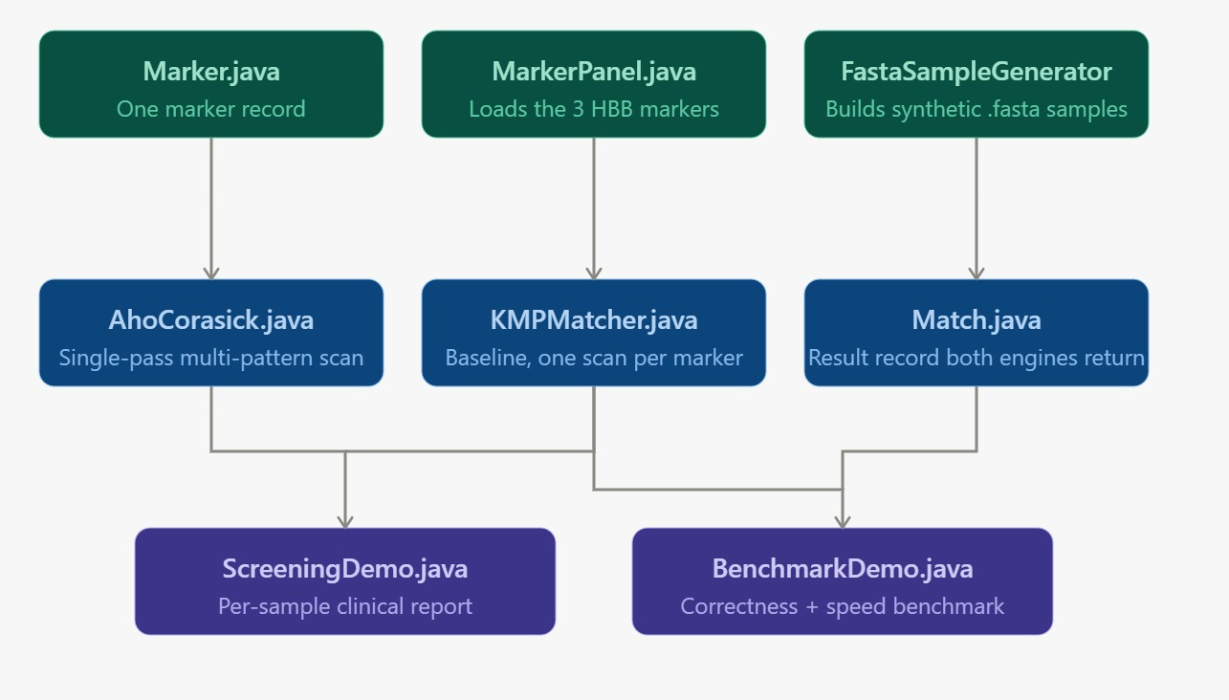
Flow Chart

Slide 8
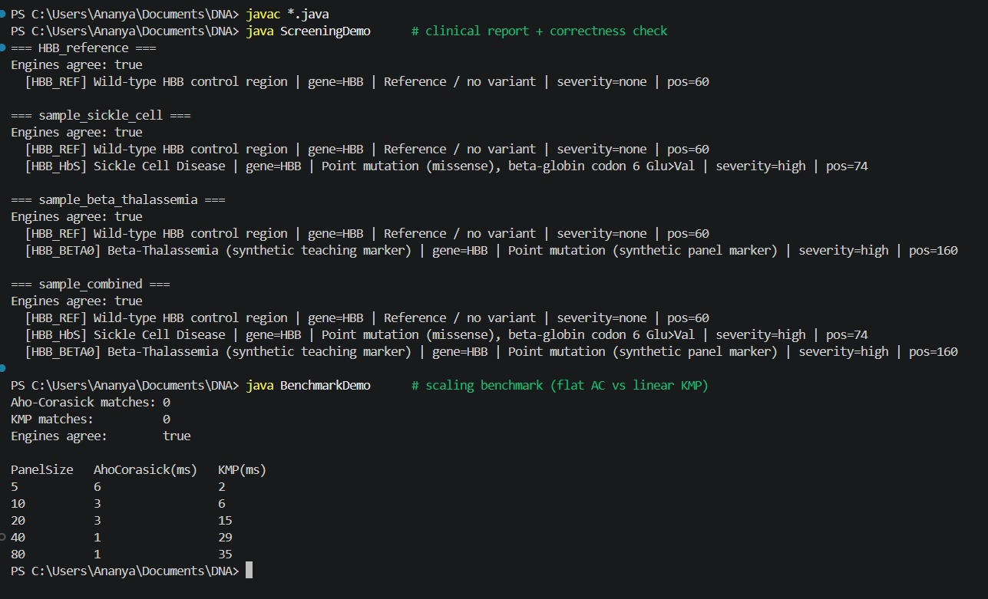
Results

Slide 9
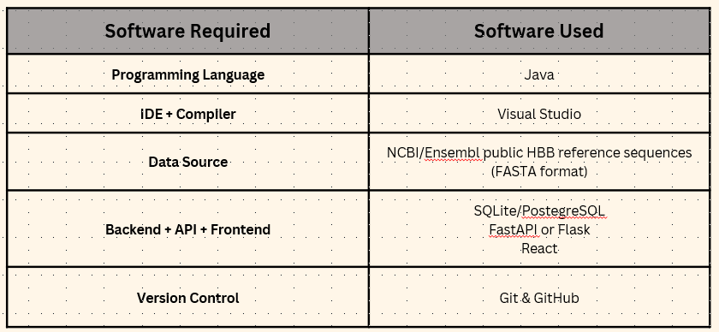
Hardware and Software requirements
Software Requirements

Slide 10
Conclusion
The Newborn Genetic Disorder Screening via DNA Motif Scanning project demonstrates how string-matching algorithms can be applied to genetic screening. The Aho–Corasick algorithm enables efficient detection of multiple DNA markers in a single scan, while KMP provides a useful baseline for performance comparison.
Using synthetic DNA data, the system identifies matching genetic motifs, stores screening results, and compares the performance of both approaches. The project provides a foundation for developing a scalable and efficient DNA screening system that can be extended with larger marker panels, additional genetic sequences, and more advanced matching techniques.

Slide 11
Future Scope
  Approximate/fuzzy matching: extend Aho-Corasick to tolerate SNPs or sequencing errors (e.g., via Aho-Corasick + edit-distance hybrid, or Bitap-style approximate matching) since real sequencing reads aren't always perfect
  Expand beyond HBB: generalize the panel to other well-characterized single-gene disorders (e.g., CFTR for Cystic Fibrosis, G6PD deficiency) to move toward a true multi-disorder newborn panel
  Parallelization: multi-threaded scanning for whole-genome-scale inputs rather than single-gene reference sequences
  Integration with real screening pipelines: FASTQ/BAM file format support instead of raw string input, aligning with actual lab workflows
  Cloud/edge deployment: package as a microservice so district-level health centers can query a centralized panel without needing local compute power
  Regulatory alignment: design report format to align with ICMR/NSCAEM reporting standards for future real-world pilot use.

Slide 12
Thank you

